Slide 1
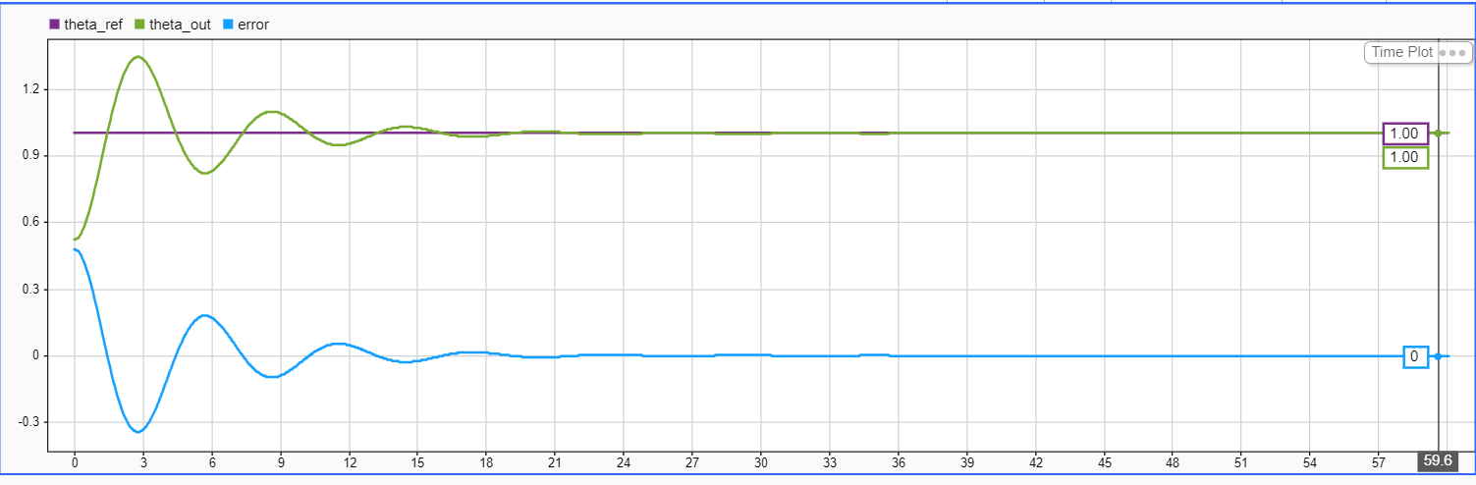
Kd=0.05

Slide 2
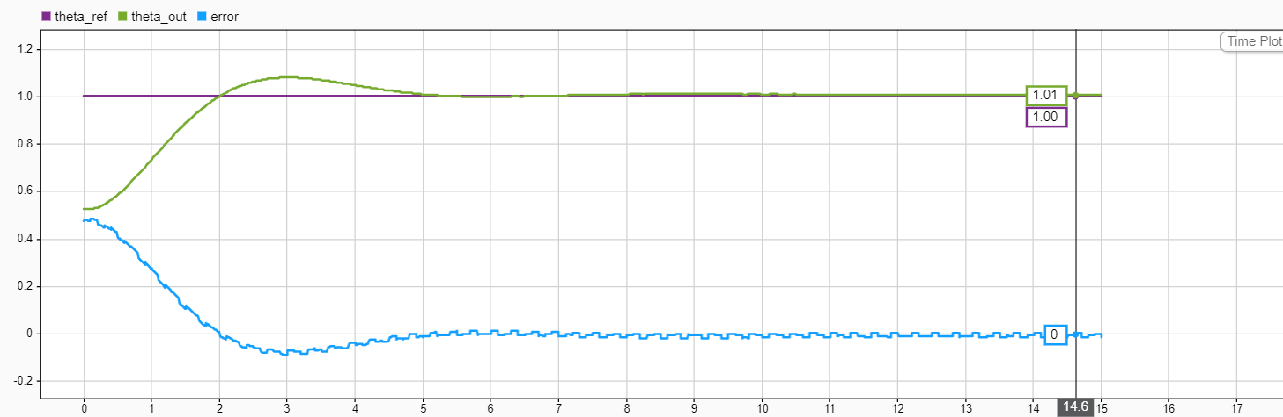

Slide 3
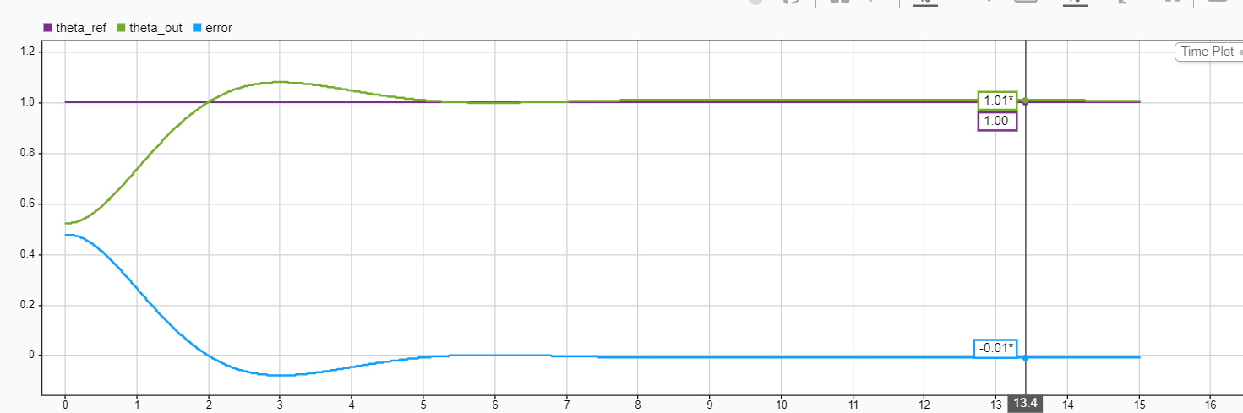
Kd=0

Slide 4
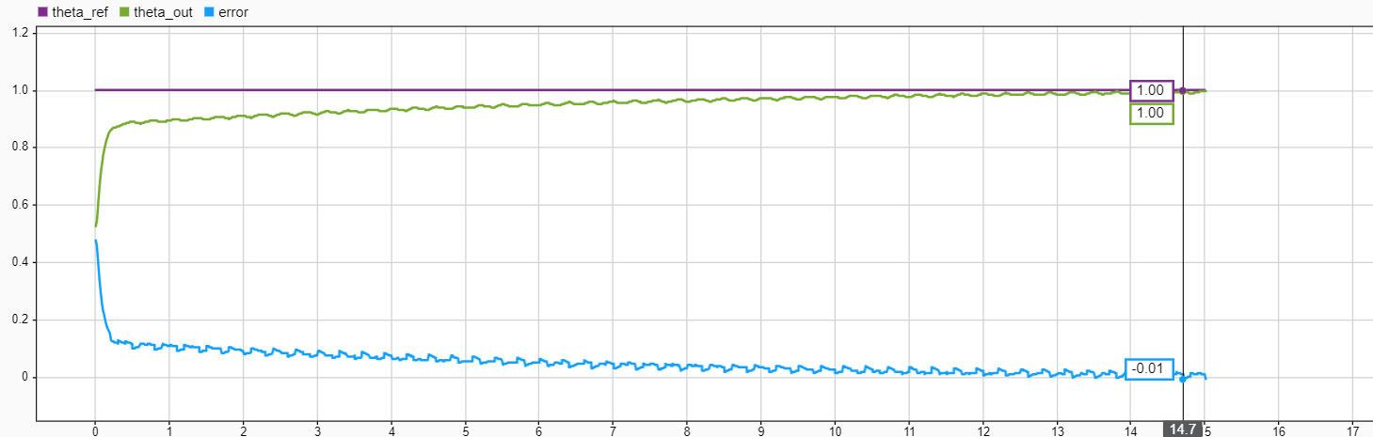

Slide 5
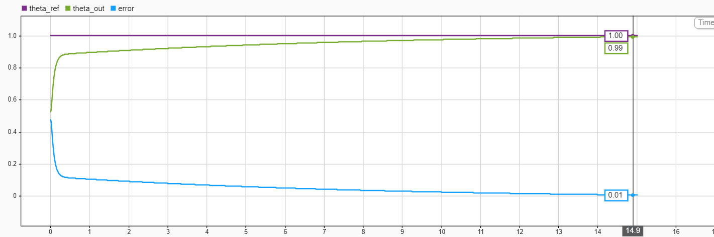

Slide 6
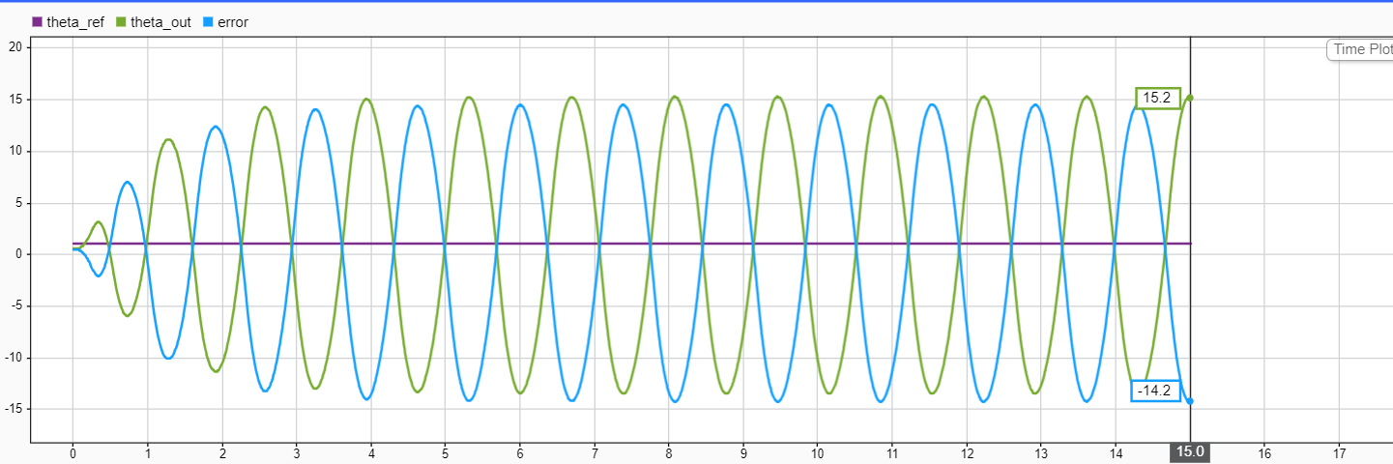
With anti wind up

Slide 7
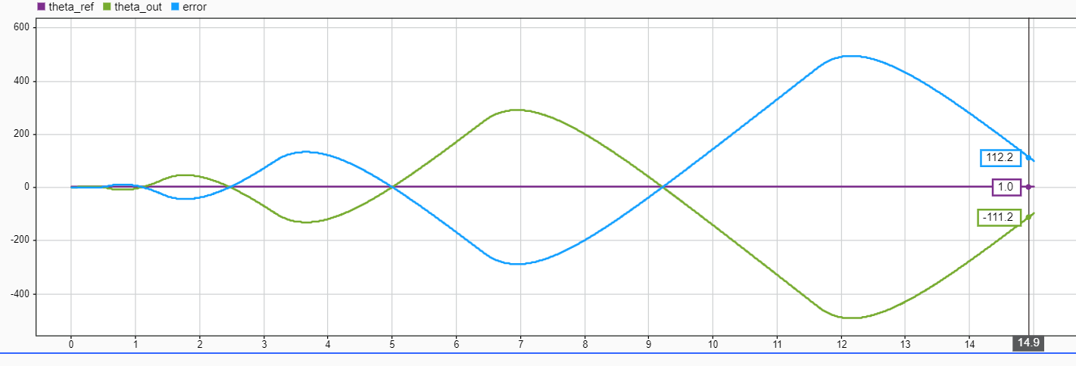
Without anti wind up

Slide 8
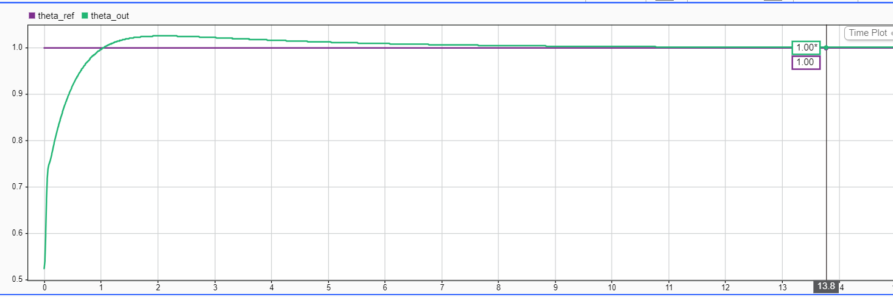
Tune with toolbox

Slide 9
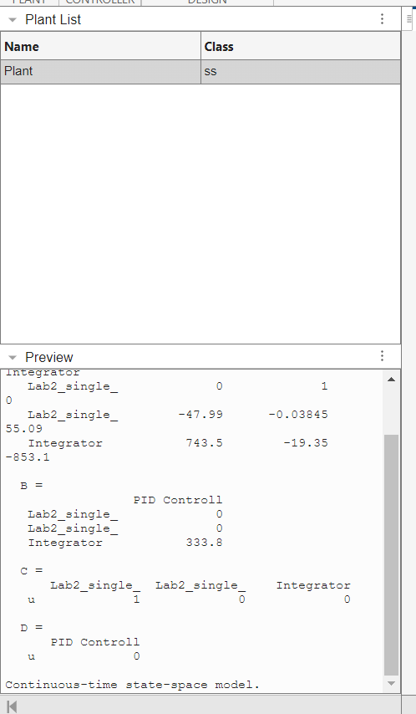
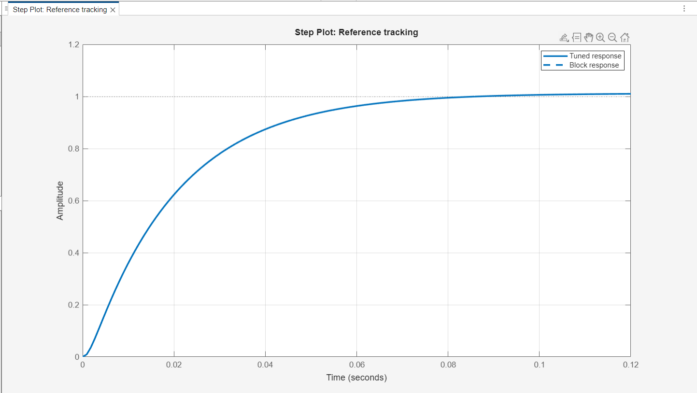
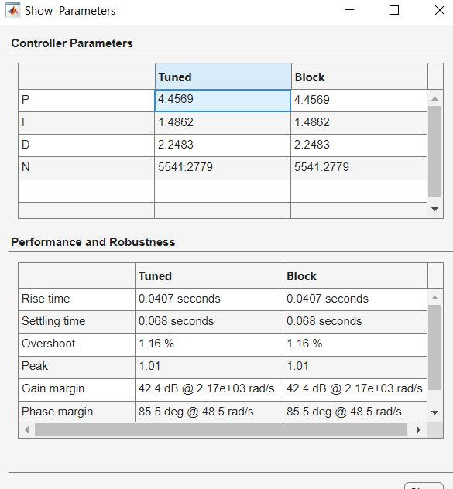
v

Slide 10
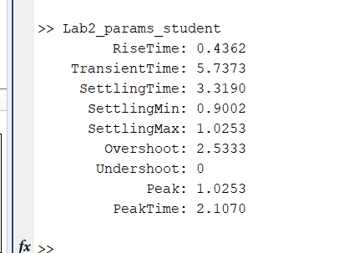
Lab2_params_student
RiseTime: 0.4362
TransientTime: 5.7373
SettlingTime: 3.3190
SettlingMin: 0.9002
SettlingMax: 1.0253
Overshoot: 2.5333
Undershoot: 0
Peak: 1.0253
PeakTime: 2.1070
>>

Slide 11
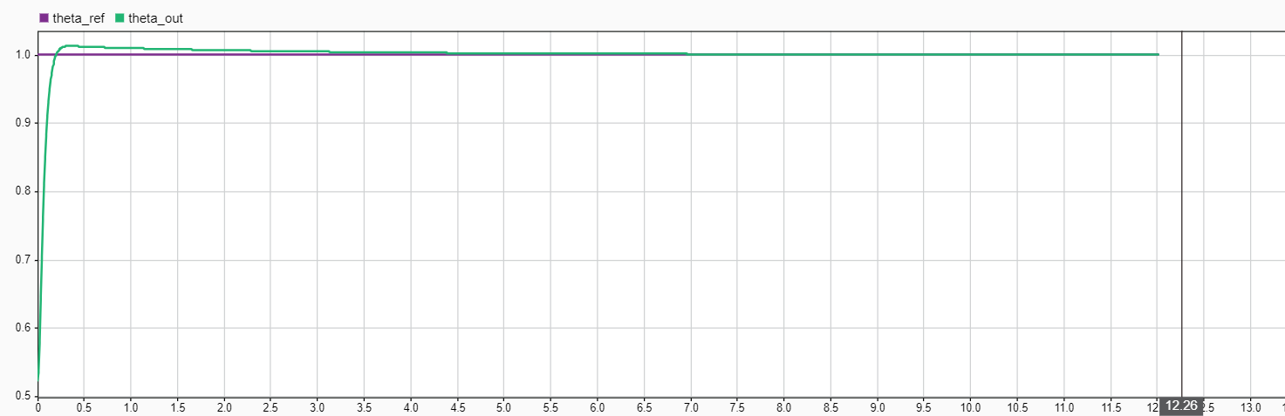
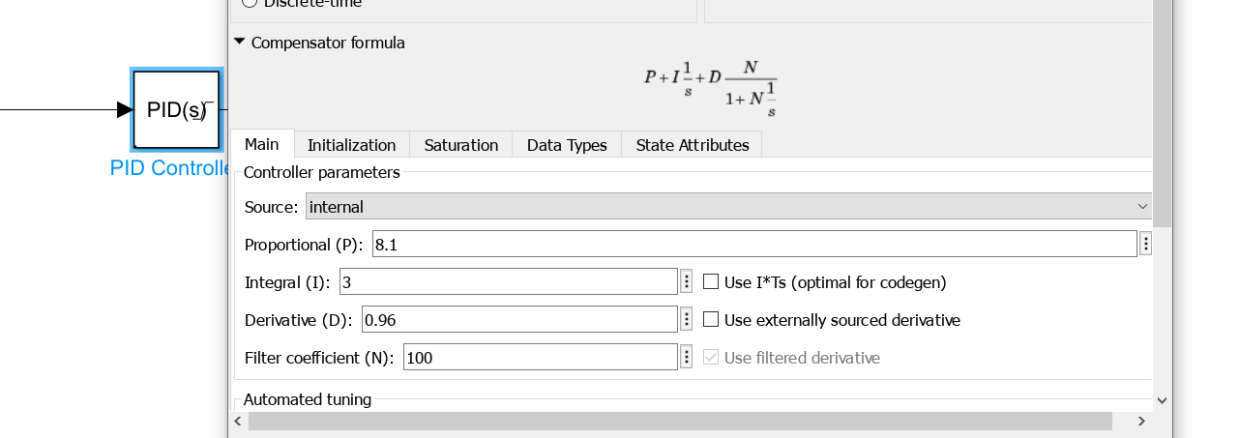
Tune manually

Slide 12
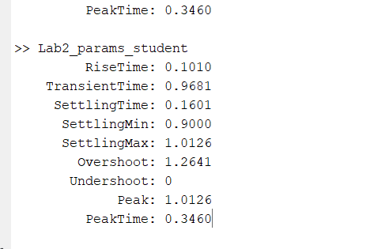
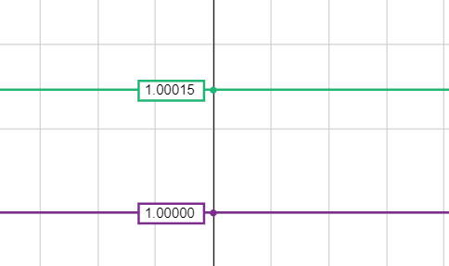
> Lab2_params_student
RiseTime: 0.1010
TransientTime: 0.9681
SettlingTime: 0.1601
SettlingMin: 0.9000
SettlingMax: 1.0126
Overshoot: 1.2641
Undershoot: 0
Peak: 1.0126
PeakTime: 0.3460
Tune manually
Final error 0.00015 rad

